Slide 1

SYRCityline Request Analysis
TIA & LIZ

Slide 2

SYRCityline Data
Our dataset is a collection of user reported service requests submitted through Syracuse's Cityline program (https://seeclickfix.com/Syracuse)
SYRCityline is a tool that allows city residents to report non-emergency service requests such as public litter, illegal trash setouts and street and sewage concerns.
Our dataset consisted of 23 columns and 68,505 rows
Notes:
The dates of the original dataset

Slide 3
Objective
Use the data to determine the effectiveness of this tool. We hope to answer the question: does the SYRCityline application perform as it was intended to and if not, why and how can it be improved. We will be determining effectiveness by resolution time.
Notes:
The dates of the original dataset

Slide 4
SYRCityline Dataset
Summary - String that users select to categorize the nature of their complaint. Can be either Large or Bulk Items, Illegal Setouts, Sewer Back-ups, Weekly Trash Pickup, Large or Bulk Items - Skipped Pickup, Home & Building Maintenance, Sewer-related Concerns, Recycling, Other Housing & Property Maintenance Concern, Street Lights, or Other.
Latitude - Latitude GPS coordinate where the address is.
Longitude - Longitude GPS coordinate where the address is.
Export tagged places - Which quadrant of the city is this address matched to (Northeast, Southeast, Northwest, or Southwest).
Created at local - When this complaint or service was requested. (This is in the format of MM/DD/YYYY - HH:MM(AM/PM)).

Slide 5
SYRCityline Dataset
Agency Name - What type of City Department was this complaint assigned to. These include:
Streets, Sidewalks & Transportation
Garbage, Recycling & Graffiti
Housing & Property Maintenance
Feedback to the City
Parking & Vehicles
Green Spaces, Trees & Public Utilities
Water & Sewage
Animals

Slide 6
SYRCityline Dataset
Acknowledged at local - When this complaint or service request was acknowledged by the City department. (This is in the format of MM/DD/YYYY - HH:MM(AM/PM)).
Closed at local - When this complaint or service request was marked as being closed by the City department. (This is in the format of MM/DD/YYYY - HH:MM(AM/PM)).
Minutes to acknowledged - The amount of time, in minutes, after it was Created at Local to being marked Acknowledged at local.
Minutes to closed - The amount of time, in minutes, after service request was created at local to when it was marked as Closed at local.
Assignee name - Which city Department was assigned to this request.

Slide 7
SYRCityline Dataset
SLA Limit - This is the limit assigned by the City of Syracuse, that puts a limit on how a request can stay in the list of tasks untouched. That amount of time, in hours, SeeClickFix will forward the request to the department head as well as an administrator to help ensure that requests are addressed in a timely manner.
Report source - How this service request was obtained: Either Web-Mobile, iPhone, Portal, Web-Desktop, Android, or Request Form.*

Slide 8
SYRCityline Dataset
ID - Identification number assigned to each incident
Rating - The number of followers on the Request in SeeClickFix.
Address - Address of the service request or complaint, provided by the community member.
Description - Write up of the service request or complaint, provided by the community member.
Request Type – Request type ID number
URL - Unique website address (url) that the complaint as well as comments from the City personnel can be viewed at.

Slide 9
SYRCityline Dataset
Category – The way a request is categorized. This can be Potholes, Large or Bulk Items, Water-related Concerns, Home & Building Maintenance, Street Lights, Weekly Trash Pickup, Public Trash Can, Yard Waste, Report Litter on Private Land, among other categories.

Slide 10
Data Cleaning and Transforming
Adding columns:
Split the date & time data into their own columns (Created at local, Closed at local, & Acknowledged at local)
SLA in mins, SLA in days, Hours to closed, Days to closed
Y/N columns for SLA met, Assigned, & Acknowledged
Closed Category, which contains bins to categorize resolution time (i.e. Two weeks, Less than a day, etc.)
Notes:
Why we transformed it
What did the dataset look like after

Slide 11
Data Cleaning and Transforming
Dealing with NAS:
Found over 56,099 lines containing NAs, but chose to keep most of them in the dataset
NAs that were removed came from Lat & Lng (76), Export tagged places (76), and all SLA related NAs(23)
Cleaned up the data in the Export tagged places column to keep data uniform. Ensured all data in these columns within data set fit within the 4 main classification: NW, NE, SE & SW. We were ablet o update most, those that could not be updated were converted into NAs and dropped
Notes:
vHow we transformed it
Why we transformed it
What did the dataset look like after

Slide 12
Data Cleaning and Transforming
The last step was to select all the columns we planned to use for our analysis
After cleaning and transforming the data, our dataset consisted of 24 rows and 68,406 rows.
Notes:
Should I list all the columns out?

Slide 13
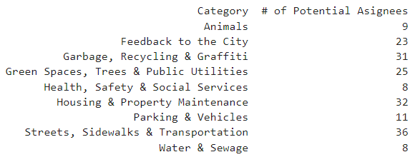
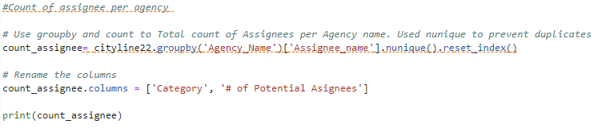
Exploratory
What we learned
There are 56 potential assignees, and most are allocated to Streets, Sidewalks & Transportation, Housing & Property Maintenance and Garbage, Recycling & Graffiti
Notes:
How well did the city resolve issues in 2022 2.5 minutes

Slide 14
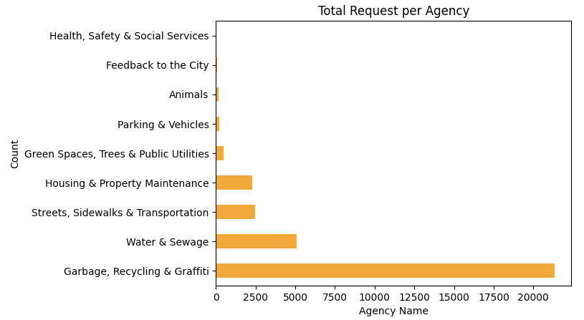
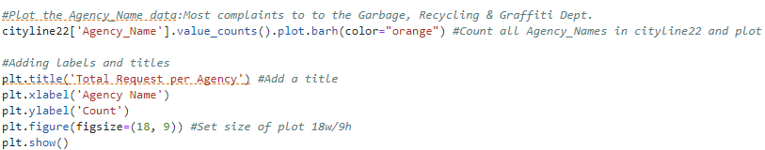
Exploratory
What we learned
There are 9 agencies that handle service requests
Of the 9 agencies, the Garbage, Recycling & Graffiti Dept. Received the most service requests
Notes:
How well did the city resolve issues in 2022 2.5 minutes

Slide 15
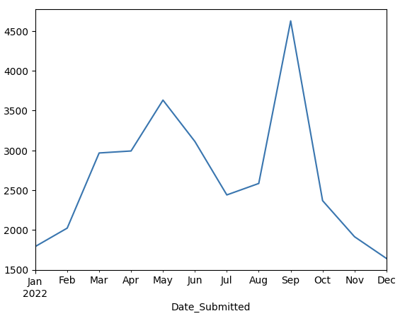
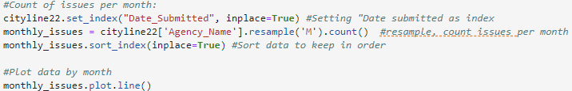
Exploratory
What we learned
September received the most requests and requests declined from there
Notes:
How well did the city resolve issues in 2022 2.5 minutes

Slide 16
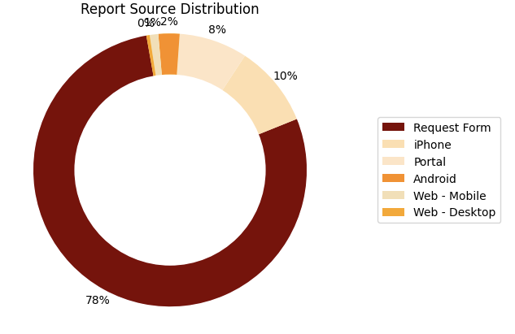
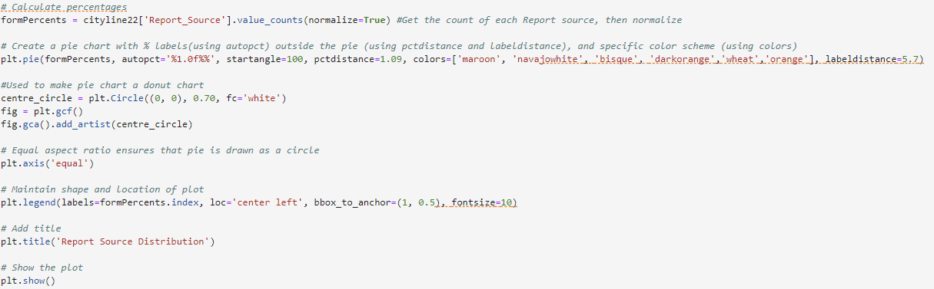
Exploratory
What we learned
Majority of requests get submitted by paper form
Notes:
How well did the city resolve issues in 2022 2.5 minutes

Slide 17
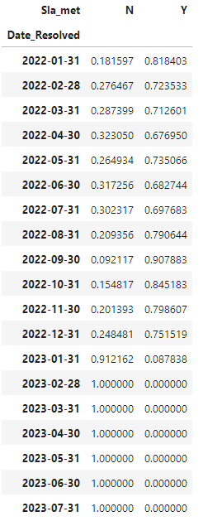
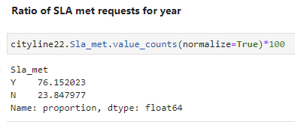
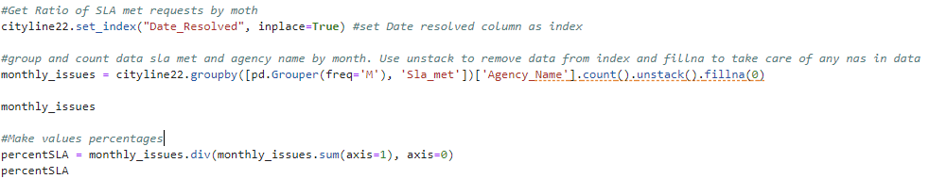
Is the city performing well? Are they fulfilling their SLAs?
What we learned
76% or service request met SLA requirements, while 24% not.
These results are consistent month to month

Slide 18
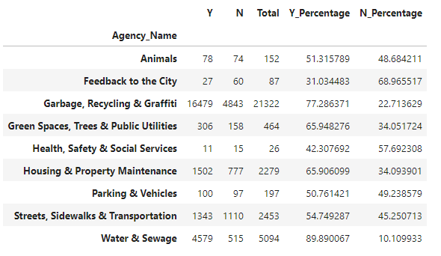
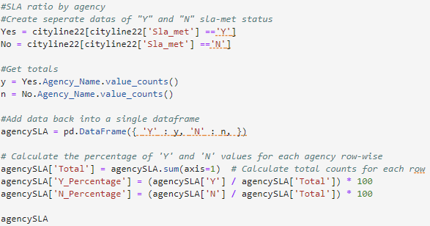
What agencies struggle the most?
What we learned
A closer look at the data shows the agencies that seem to struggle the most with SLA are Feedback to the City and Health, Safety & Social Services and Parking & Vehicles
Notes:
How well did the city resolve issues in 2022 2.5 minutes

Slide 19
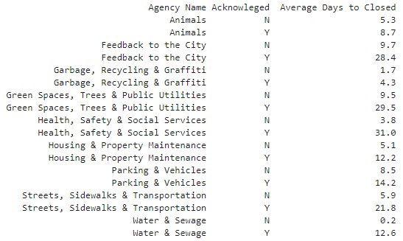
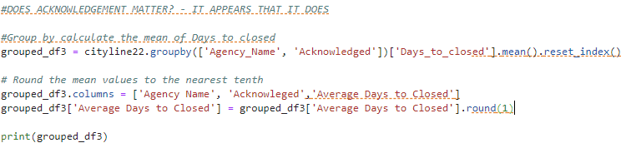
Does acknowledgement status affect an agencies resolution time?
What we learned
Whether something is acknowledged makes a big difference, likely these take more time to resolve

Slide 20
Recommendations
Update SLA limits and categories
Difficult to compare SLA when the categories themselves can contain multiple limits
Parsing limits will help distinguish requests that will take more time over others
Information is possibly presented different depending on request form causing minor differences
Suggest estimate time for completion
It did not appear that information was provided to residents once a request was submitted

Slide 21
Issues & Continued Work
Possible Model Prediction for completion times
Help ensure tickets are being completed on time/sooner
Consider what information may be correlated together
Additional column to identify assigned by individual or team

